Slide 1
C++ Programming
Jerry Lebowitz

Slide 2

Topics
Array of pointers
Command line parameters
Friend functions
Overloaded Operators
Static Data Members

Slide 3
Arrays of Pointers
char * ptrArray[5] is a char and since [ ] has a higher precedence than * ptrArray is array of five character pointers
See apointers1.cpp through apointers3.cpp
These
are
pointers
to
strings

Slide 4
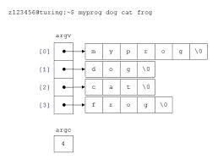
Command Line Parameters
Passing information from O/S to C++
Declare arguments to main()
int main( int argc, char *argv[ ] ) // array of character pointers
int main( int argc, char **argv ) // array of character pointers
argc is the number of parameters (program name is the first)
argv[ ] contains the addresses of the command line parameters (is an array of character pointers that point to the actual arguments)
See command1.cpp

Slide 5
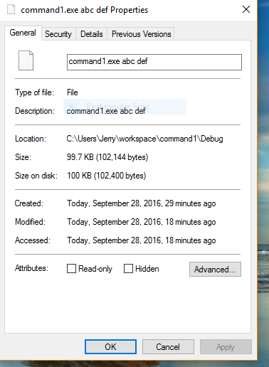
Command Line Parameters Interface

Slide 6
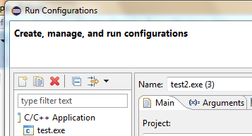
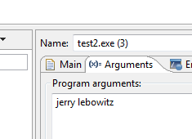
Command Line Parameters within Eclipse

Slide 7

Friend Functions
The concepts of encapsulation and data hiding dictate that only member functions should be able to access an object’s private data
There are some instances where it is convenient for non-member functions to be able to access an object’s private members
If a client or member function needs to manipulate objects of two different classes, there is nothing like a “friend”

Slide 8


Friend Functions (1)
A friend function of a class is not a member function of the class but has access to private members of that class
To make a function friend to a class, the reserved word friend precedes the function prototype (in the class definition)
The word “friend” doesn’t appear in the definition of the friend function
One does not use the dot operator invoking to a friend function

Slide 9

Friend Functions (2)
A class can grant a function access to all its members (public or private)
One cannot choose their friends
Use of friend functions is controversial since it violates the “private data” paradigm
If one is using too many friends, a design change would be a good idea
Often used when overloading operators

Slide 10

Sample Friend Function
Sample friend specifications
friend int friendFunction(alpha, beta); // friend function
(alpha and beta are classes)
See friend1 through friend3.cpp

Slide 11

Nested Classes (1)
A declaration of a class may appear in within another class
Such declaration declares a nested class
A nested class is a member and as such has the same access rights as any other member
Like any member of its enclosing class, the nested class has access to all names (private and protected, members) to which the enclosing class has access to

Slide 12

Nested Classes (2)
The members of an enclosing class have no special access to members of a nested class; the usual access rules shall be obeyed
See friend4 and friend5.cpp

Slide 13
Self Referencing Pointer
Member functions of every object have access to a pointer named “this”
Every member function can find out the address of the object by using the “this” pointer
Called a self-reference
See this1.cpp

Slide 14
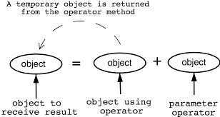
Overloaded Operators
Used to transform complex statements into more intuitive ones
Allows one to overload most of the operators to work effectively in a specific application
Alternate ways to represent adding of objects
1. object3.addobjects(object1,object2);
2. object3=object1.addobjects(object2);
3. object3=object1+object2;
Statement #3 is “more intuitive”

Slide 15
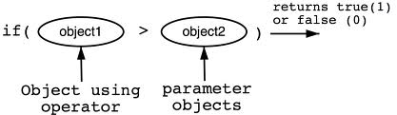
Overloaded Operators Rules
Most of the existing operators can be overloaded to manipulate class objects
Overloaded operator must comply with the language syntax
Division is a binary and not a unary operator
Cannot overload operators of built-in data types
Cannot overload the + operator for integers
Cannot invent new operators

Slide 16

Overloaded Operators Rules (2)
The operators = and & are predefined for objects
One can make these operators inaccessible by declaring them private or they can be overridden by new definitions
Need to use the keyword “operator”
Overloadable operators
+ - * / % ^ & | ~ ! ' = < > <+ >= ++ -- << >> == != && ||
+= -= /= %= ^= &= |= *= <<= >>= [ ] ( ) -> new delete

Slide 17
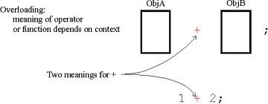
Overloaded Operators Rules (3)
Precedence of the operator cannot be changed
The number of arguments cannot be changed
The operators = and + and += are separate operators
For binary operators
The argument on the left hand side is the object of which the operator is a member function
The object on the right hand side must be furnished as an argument to the operator
Unary operators do not require arguments

Slide 18
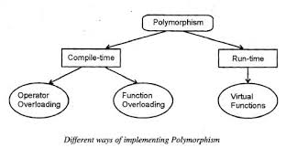
Syntax for Overloaded Operators
The syntax of the heading of an operator function is
returnType operator operatorSymbol([arguments]) ;
Binary operators (arithmetic and relational)
returnType operator operatorSymbol(const className&) const;
Unary operators
returnType operator operatorSymbol() const;
To overload an operator for a class:
Write the function to overload the operator (that is, the operator function) in the definition of the class

Slide 19

Syntax to Overload the + and * Operators
Syntax to overload the binary + (addition) and * (multiplication) operators for objects
(objectA+objectB or objectA*objectB)
returnType operator op(const className&);
op stands for the binary operator to be overloaded
returnType is the type of the value returned by the function
className is the name of the class for which the operator is being overloaded
For example:
OpOverClass operator+ (const OpOverClass&) const;
OpOverClass operator* (const OpOverClass&) const;
See overload1.cpp

Slide 20
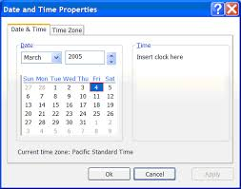
Sample Operator Overloading
class Date
{
public:
...
friend istream& operator >> (istream& input, Date& inputDate);
friend ostream& operator << (ostream& output, Date& outputDate);
// Note: friendship was granted by ifstream and ostream
// Member functions to overload operators
int operator<(const Date&); // less than
int operator==(const Date&); // equal
Date operator+(int); // overloaded + to add a day
Date operator+=(int);
Date operator++( ); //prefix ++ operator
Date operator++(int); //postfix ++ operator
Date operator=(const Date&); //assignment operator
See overload2.cpp

Slide 21
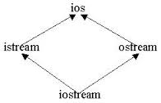
Overloading Stream Insertion (<<) and Extraction (>>) Operators
The operator function that overloads the insertion operator << or the extraction operator >> for a class must be a nonmember of that class
Consider the following expression:
cin>>myDate;
In this expression, the left most operand of >>, that is, cin is an istream variable, not an object of the Date class
Since the left most operand of >> is not an object of the Date class, the operator function that overloads the extraction operator for the Date class must be a nonmember of the Date class
Similarly, the operator function that overloads the stream insertion operator for the Date class must be a nonmember function of Date class

Slide 22

Overloading the Stream Insertion Operator (<<)
Function Prototype:
friend ostream& operator<<(ostream&, const className& );
Function Definition:
ostream& operator<<(ostream& osObject, const className& object)
{
//Output members of the object
//osObject<<. . .
…….
//return stream object
return osObject;
}

Slide 23
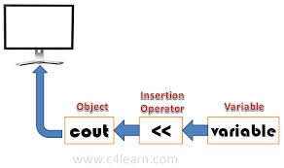
Overloading the Stream Extraction Operator (>>)
Function Prototype:
friend istream& operator>>(istream&, className&);
Function Definition:
istream& operator>>(istream& isObject, className& object)
{
//Read data into the object
//isObject>>. . .
……………………...
//return stream object
return isObject;
}

Slide 24
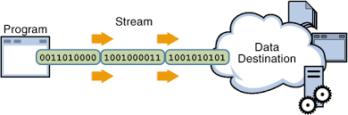
Stream Insertion Operator (<<)
ostream& operator << (ostream& output, Date& outputDate) // cout operator
{
output << outputDate.month << "/" << outputDate.day << "/"
<< outputDate.year << endl;
return output;
}

Slide 25
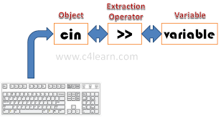
Extraction Operator (>>)
istream& operator >> (istream& input, Date& inputDate) // cin operator
{
cout << "\nEnter month: ";
input >> inputDate.month;
cout << "\nEnter day: ";
input >> inputDate.day;
cout << "\nEnter year: ";
input >> inputDate.year;
return input;
}
See overload3.cpp

Slide 26

Overloaded Operator Example (non-member functions)
Function prototype required
friend returnType operator#(const className&, const className&)
Example:
friend bool operator==(const Date&, const Date&)

